Slide 1






SLEEP OPTIMISER
ADHARSH RJ
SURYAKAILASH R

Slide 2

INTER-DEPENDENT PARAMETERS
WORKFLOW
Optimization of sleep exercise and nutrituion leads to an increase in workflow
EXERCISE
Energy expenditure due to exercise depends on the amount of work done per unit time.
FACTOR AFFECTING ENERGY EXPENDITURE
EXERCISE WISE CALORIE EXPENDITURE
NUTRITION
The composition of an astronaut’s nutrition plan in calories is 55-60% from carbohydrates, 30% from fat and 10-15% from proteins.
Calorie Composition
Energy Expenditure
SLEEP
Sleep is one of the most important parameters that determines the daily well being of a person.
CONSTITUENTS
QUALITY ASSESSMENT

Slide 3

BASAL METABOLIC RATE
BMR is the rate at which energy expenditure takes place per unit time in endothermic animals at rest
i.e. it is the amount of calories burned by an endothermic animal per unit time.
59 Calculation for Male
BMR for a male is calculated using the formula
66.47 + (13.75 X Weight in KG) + (5.003 X Height in CM) – (6.755 X Age in YEARS)
65 Calculation for Female
BMR for a female is calculated using the formula
655.1 + (9.563 X Weight in KG) + (1.85 X Height in CM) – (4.676 X Age in YEARS)

Slide 4
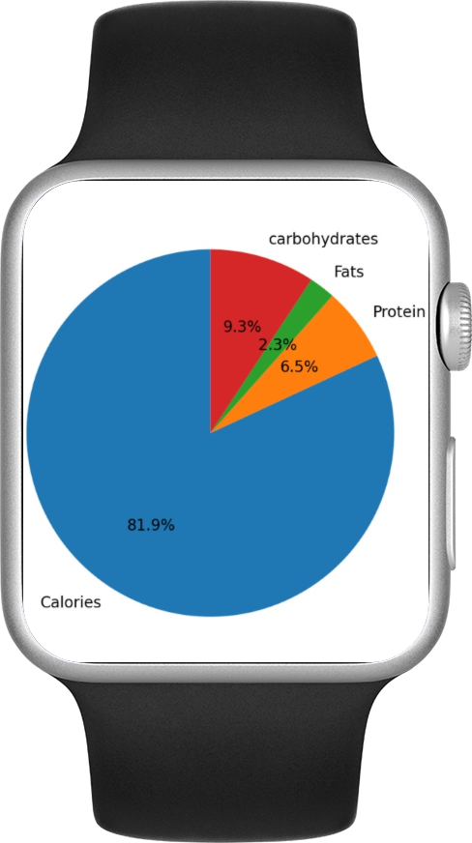
OVERCOME
DEFICIENCIES
ORGANIC SOLUTIONS
NUTRIENT TRACKING
HELPS TO MAINTAIN
PEAK PERFORMANCE

Slide 5

EXERCISE VARIATION
Running, cycling and other exercises.
EXERCISE MONITOR
Duration and Variations are monitored
PERSONALIZATION
With respect to other parameters.

Slide 6

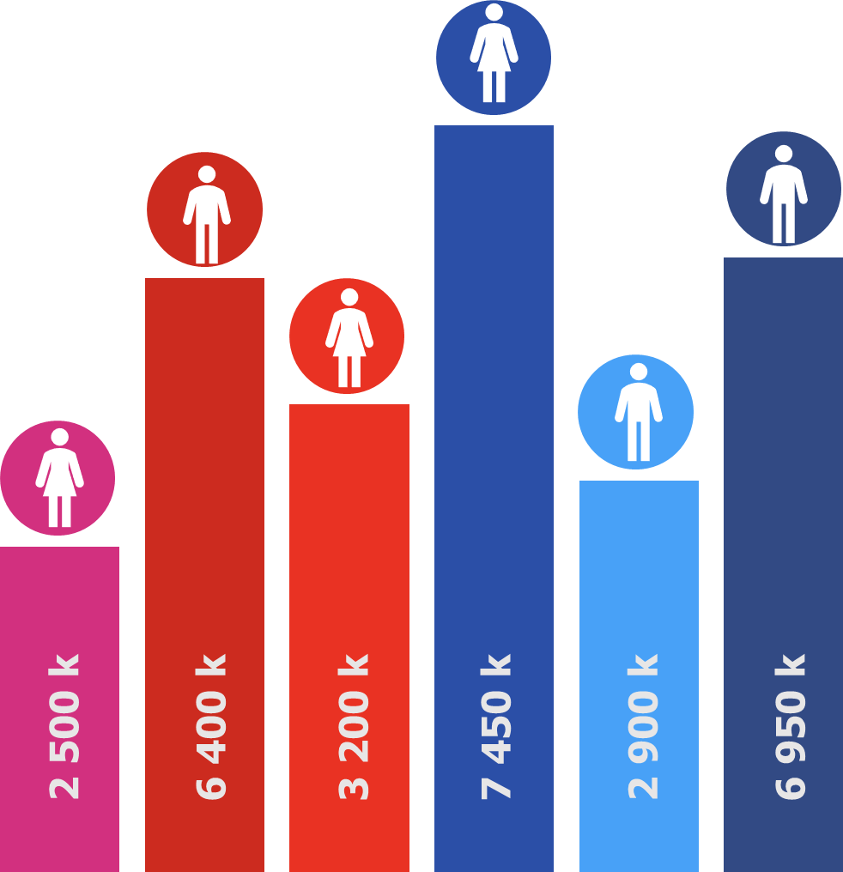
FACTORS AFFECTING SLEEP
01
02
The data received is visualized in the form of a graph.
Using the data the sleep hours and working hours are scheduled
Helps in the improvement of Circadian Rhythm
EFFICIENCY
EFFECTS OF ILLUMINATION
REM VARIATIONS
SLEEP LATENCY

Slide 7

THANK
YOU

